Slide 1


Welcome & introduction
TFMM co-chairs
Augustin Colette & Oksana Tarasova
22nd TFMM annual meeting, 10-12 May 2021
Remote Meeting

Slide 2
Welcome
Agenda of the meeting
Progress in 2020-2021 workplan
  Revision of Gothenburg protocol
Preparation of 2022-2023 workplan

Slide 3
Monday 10/5 pm
Welcome
Meeting objective
Information from Convention and Centers
Outreach: GAW/ACTRIS
Eurodelta-Carb: PM&BaP

Slide 4
tuesday 11/5 AM
Monitoring techniques
Split sessions: 2022-2023 Workplan

Slide 5
tuesday 11/5 PM
Split sessions: 2022-2023 Workplan
Country updates
2020 Lockdown & AQ
Gothenburg Protocol Review

Slide 6
wednesday 12/5 am
Gothenburg Protocol Review
Final discussions

Slide 7
Gothenburg protocol Review
Notes:
Mention links with HTAP for O3

Slide 8
Gothenburg protocol Review
2.1: TFMM: Trends & Scales
  (Preliminary draft provided early april 2021, will evolve in further iteration, accounting for discussions during this meeting)
Notes:
Mention links with HTAP for O3

Slide 9
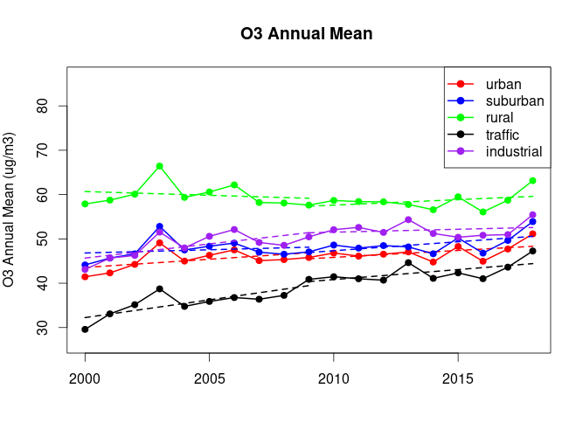
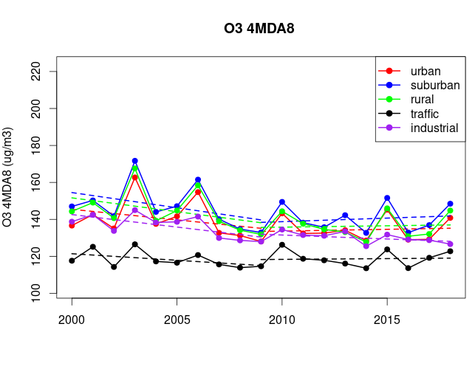
GP Review: O3 trends
  Sensitivity to metric, station typology, geographic area
  2000-2018:
    annual mean ozone decreased 3% at rural sites (inc. EMEP), but increased 11% at urban sites (EEA AQ e-reporting)
    peaks (4MDA8) decline systematically 11% to 6% at rural and urban sites, respectively
    => Disappointing considering -47% and -54% reduction in NMVOC and NOx emissions
  After 2010: very flat trend for ozone peaks, except in southern Europe
  Projected climate change will carry a penalty, leading to increases in ozone peaks

Slide 10
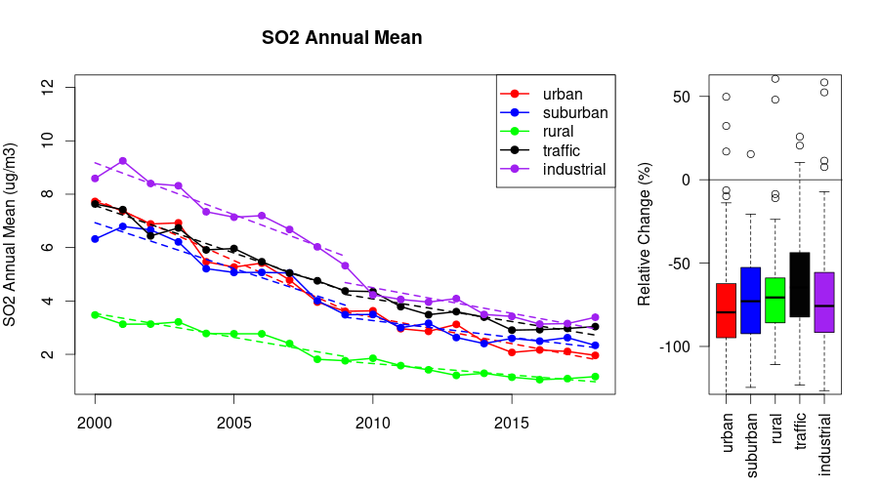
GP Review: SO2, NO2, PM trends
  SO2 concentrations have declined by 83% at rural sites, quite in line with the reported 91% downward trend in emission
  The trend in observed NO2 concentration (37% and 28% decline at rural and urban sites, respectively) is however much lower than the reported decline in European emissions, which is 55%.
  PM10 declined about 45%, which is more than the 30% reduction in PPM emission, thanks to the additional effect of gaseous PM precursors
  The abrupt emission changes associated with the lockdown measures in Europe during COVID-19 provide a real life experiment to improve our understanding of the processes that controls the response in terms of atmospheric concentrations

Slide 11
GP Review: trend factors
Disentangle the contribution of (i) European emissions, (ii) meteorology, (iii) local&distant sources
Methods
  Modelling : sensitivity CTM simulation (on/off experiments, Eurodelta), statistical decomposition (meteorological predictors)
  Monitoring: twin site, proof of concept but long term trend are limited
Results
  ozone trends are dominated by European emissions, hemispheric background is important, esp for annual mean O3, meteorology is an important source of variability, also for peaks
  For PM trends, the role of European emissions largely dominates

Slide 12
Gothenburg protocol Review
Notes:
Mention links with HTAP for O3

Slide 13
2022-2023 workplan
Split sessions
  Synergies to address LRTAP’s expecteation (Long Term Strategy)
  Field Campaigns & Multi-model exercises
  Long term versus short term (intensive)
Topics
  Ozone:
    Metrics, trends, and scales: spatial (global / local), temporal (Climate)
    Chemistry (VOC/CH4)
  Aerosols:
    Condensables: SVOC/IVOC
    Complementarity of long term (ex: filters) vs NRT (ex: ACSM)
    Fine/coarse (inc. Natural)
  BaP / Chem Emerg. Concern / Microplastics
      Monitoring species with potential for long-range impacts
      HM/POP modelling case studies
Tuesday am: Split sessions
Tuesday pm: feedback to plenary + open discussion
Wed. Am: Proposal for priorities

